Slide 1
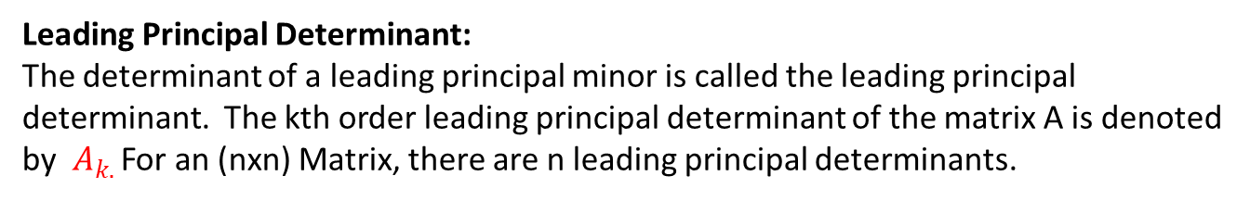
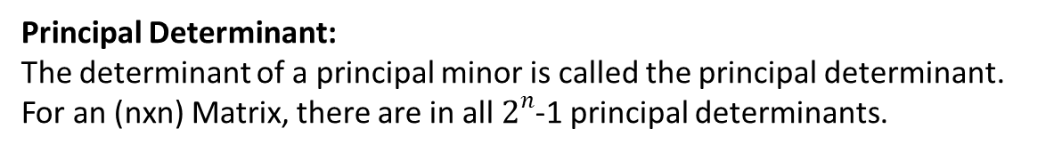
Definitions (Matrix Theory):
Principal Minor :
If A is an( nxn) matrix, then the principal minor of order k is a submatrix
Of size (kxk) obtained by deleting any (n-k) rows and their corresponding columns from the matrix A. The diagonal elements of the matrix are principal minor of order 1.
Principal Determinant:
The determinant of a principal minor is called the principal determinant. For an (nxn) Matrix, there are in all $2^{n}$-1 principal determinants.
Leading Principal Minor:
If A is an( nxn) matrix, then the leading principal minor of order k is a submatrix
Of size (kxk) obtained by deleting the last (n-k) rows and their corresponding columns from the matrix A.
Leading Principal Determinant:
The determinant of a leading principal minor is called the leading principal determinant. The kth order leading principal determinant of the matrix A is denoted by $A_{k. }$For an (nxn) Matrix, there are n leading principal determinants.

Slide 2
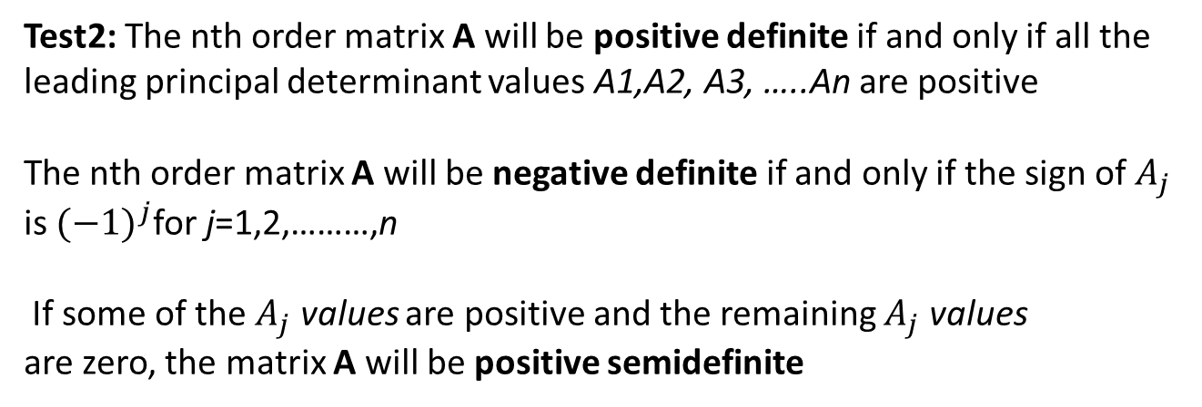
Test for Nature of the Matrix
Test 1: A matrix A will be positive definite if all its eigenvalues are positive. Similarly, the matrix A will be negative definite if its eigenvalues are negative.
It is positive-semidefinite if all its eigenvalues are all greater than or equal to zero
It is negative-semidefinite if all its eigenvalues are all less than or equal to zero
Test2: The nth order matrix A will be positive definite if and only if all the leading principal determinant values A1,A2, A3, …..An are positive
The nth order matrix A will be negative definite if and only if the sign of $A_{j}$ is ${(−1)}^{j}$for j=1,2,………,n
If some of the $A_{j}$ values are positive and the remaining $A_{j}$ values
are zero, the matrix A will be positive semidefinite

Slide 3
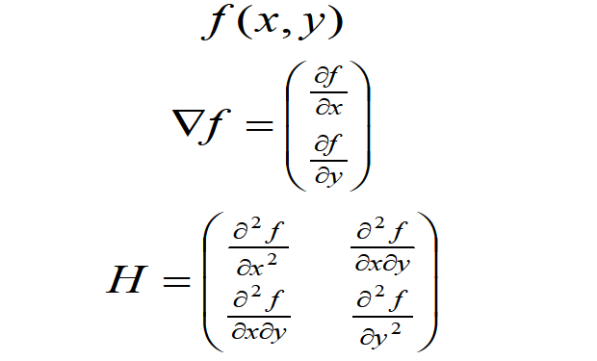
Gradient and Hessian matrix of a function f(x,y)
The Gradient of a function f(x,y) and Hessian matrix of f(x,y) are defined as follows :

Slide 4
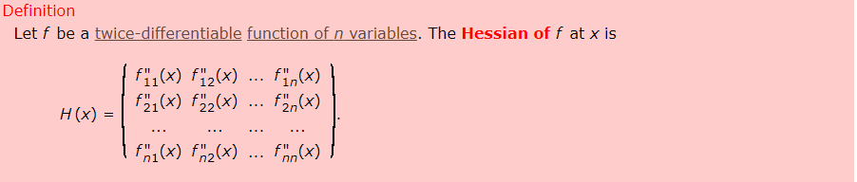
We can determine the concavity/convexity of a function by determining whether the Hessian is negative or positive semidefinite, as follows.
Proposition:
Let f be a twice-differentiable function of many variables on the convex open set S and denote the Hessian of f at the point x by H(x). Then
f is concave if and only if H(x) is negative semidefinite for all x ∈ S
If H(x) is negative definite for all x ∈ S then f is strictly concave
f is convex if and only if H(x) is positive semidefinite for all x ∈ S
If H(x) is positive definite for all x ∈ S then f is strictly convex.

Slide 5
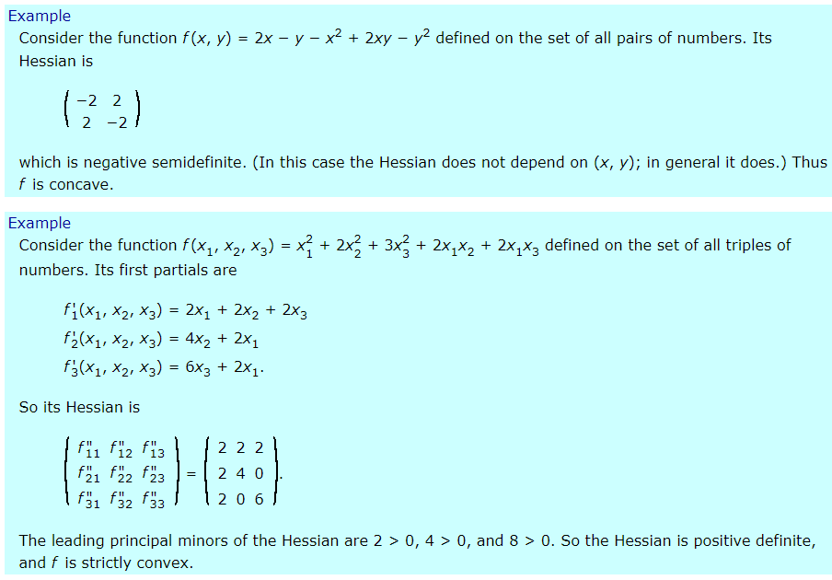

Slide 6
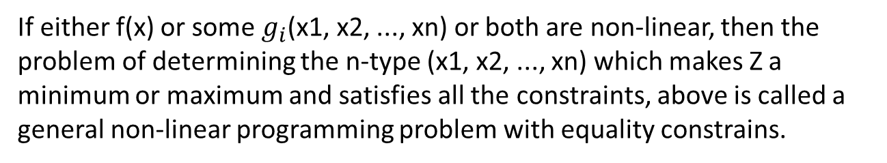
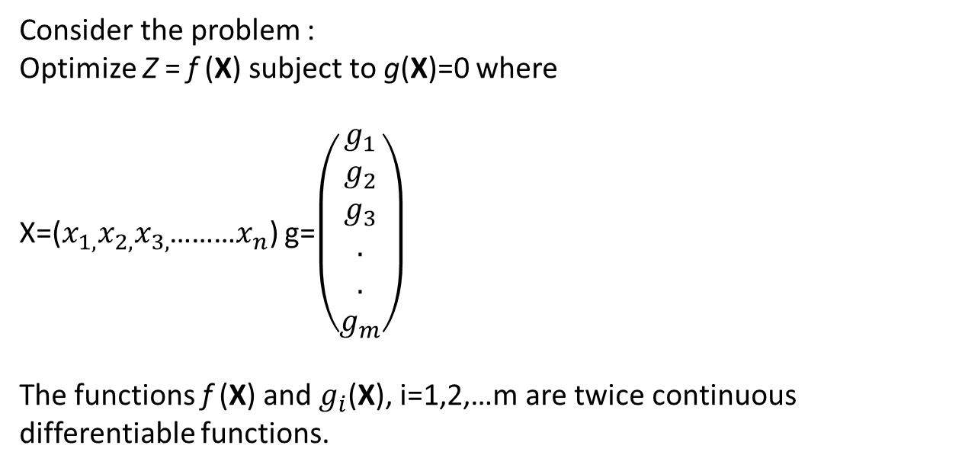
Constrained Optimization Problem
Consider the problem :
Optimize Z = f (X) subject to g(X)=0 where
X=($x_{1,}x_{2,}x_{3,}$………$x_{n}$) g=$\left(\begin{aligned}g_{1} \\ g_{2} \\ g_{3} \\ . \\ . \\ g_{m}\end{aligned}\right)$
The functions f (X) and $g_{i}$(X), i=1,2,…m are twice continuous differentiable functions.
If either f(x) or some $g_{i}$(x1, x2, ..., xn) or both are non-linear, then the problem of determining the n-type (x1, x2, ..., xn) which makes Z a minimum or maximum and satisfies all the constraints, above is called a general non-linear programming problem with equality constrains.

Slide 7
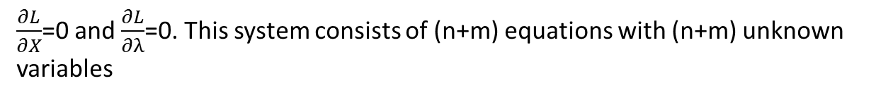
Solution by Lagrange multipliers
The method of Lagrange multipliers is a general mathematical technique that can be used for solving constrained optimization problems consisting of a nonlinear objective function and one or more linear or nonlinear constraint equations.
Step1 : Create the Lagrangean function of the form
L(X,λ) = f(X) - λg(X)
Where the parameter λ is called the Lagrange multiplier
Step2: Solve the following system of equations(These equations are the necessary Conditions for a point to be a stationary point)
$\frac{∂L}{∂X}$=0 and $\frac{∂L}{∂λ}$=0. This system consists of (n+m) equations with (n+m) unknown variables
Let ($X_{0}$,$λ_{0}$) be the stationary point for the Lagrangean function L

Slide 8

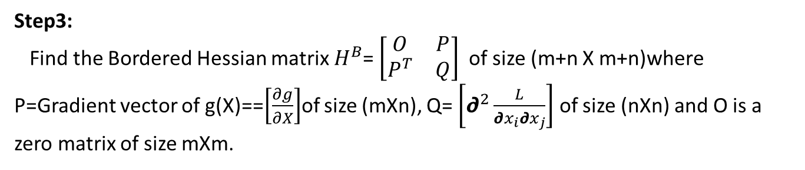
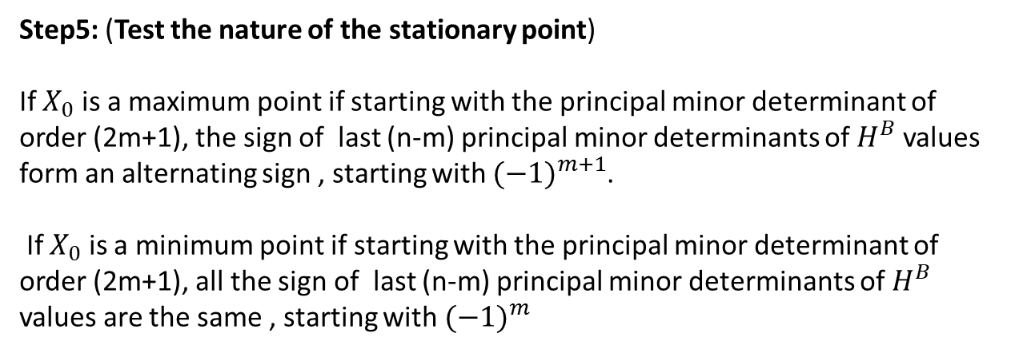
Step3:
Find the Bordered Hessian matrix $H^{B}$= $\left[\begin{matrix}O & P \\ P^{T} & Q\end{matrix}\right]$ of size (m+n X m+n)where P=Gradient vector of g(X)==$\left[\frac{∂g}{∂X}\right]$of size (mXn), Q= $\left[∂^{2}\frac{L}{∂x_{i}∂x_{j}}\right]$ of size (nXn) and O is a zero matrix of size mXm.
Step4:
Given the stationary point ($X_{0}$,$λ_{0}$) for the Lagrangean function L and the Bordered Hessian matrix $H^{B}$ evaluated at the stationary point.
Step5: (Test the nature of the stationary point)
If $X_{0}$ is a maximum point if starting with the principal minor determinant of order (2m+1), the sign of last (n-m) principal minor determinants of $H^{B}$ values form an alternating sign , starting with ${(−1)}^{m+1}$.
If $X_{0}$ is a minimum point if starting with the principal minor determinant of order (2m+1), all the sign of last (n-m) principal minor determinants of $H^{B}$ values are the same , starting with ${(−1)}^{m}$

Slide 9

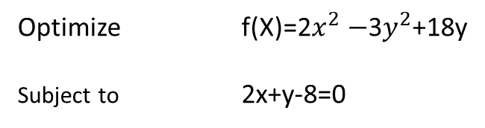
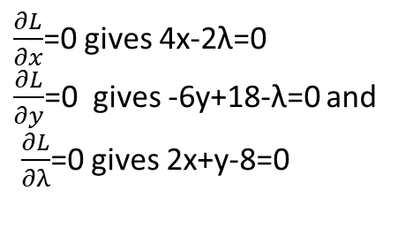
Example : Solve the following NLP
Optimize f(X)=2$x^{2}−$3$y^{2}$+18y
Subject to 2x+y-8=0
L(x,y,λ)= 2$x^{2}−$3$y^{2}$+18y- λ(2x+y-8)
$\frac{∂L}{∂x}$=0 gives 4x-2λ=0
$\frac{∂L}{∂y}$=0 gives -6y+18-λ=0 and
$\frac{∂L}{∂λ}$=0 gives 2x+y-8=0
The solution of the above system of equations is x=3 ; y=2 ; λ=6

Slide 10

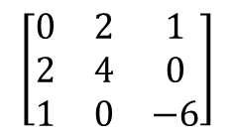
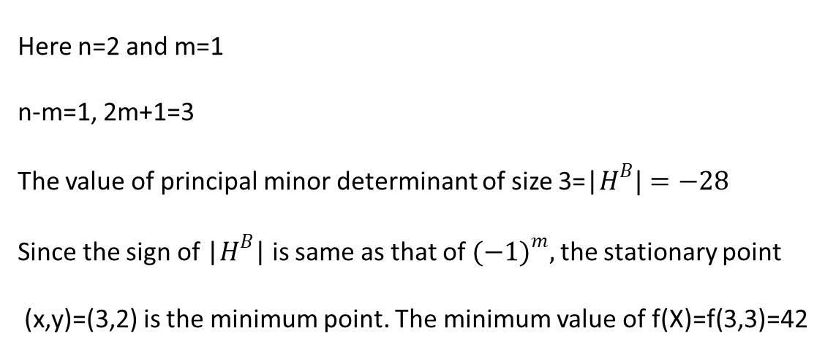
The Bordered Hessian matrix $H^{B}$=
$$\left[\begin{matrix}0 & 2 & 1 \\ 2 & 4 & 0 \\ 1 & 0 & −6\end{matrix}\right]$$
Here n=2 and m=1
n-m=1, 2m+1=3
The value of principal minor determinant of size 3=|$H^{B}|=−28$
Since the sign of |$H^{B}$| is same as that of ${(−1)}^{m},$ the stationary point
(x,y)=(3,2) is the minimum point. The minimum value of f(X)=f(3,3)=42

Slide 11
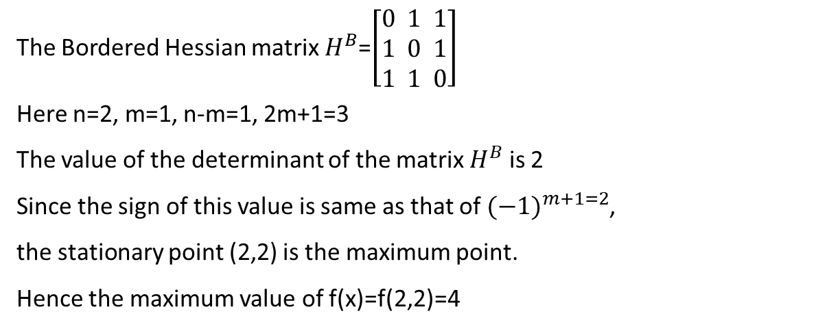
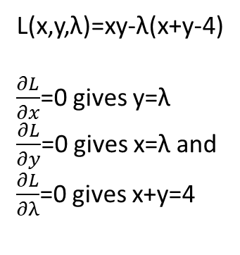
Example : Use Lagrange multiplier method to solve the following NLP:
Optimize f(X)=xy
subject to x+y=4.
L(x,y,λ)=xy-λ(x+y-4)
$\frac{∂L}{∂x}$=0 gives y=λ
$\frac{∂L}{∂y}$=0 gives x=λ and
$\frac{∂L}{∂λ}$=0 gives x+y=4
(2,2) is a stationary point
The Bordered Hessian matrix $H^{B}$=$\left[\begin{aligned}0 1 1 \\ 1 0 1 \\ 1 1 0\end{aligned}\right]$
Here n=2, m=1, n-m=1, 2m+1=3
The value of the determinant of the matrix $H^{B}$ is 2
Since the sign of this value is same as that of ${(−1)}^{m+1=2}$,
the stationary point (2,2) is the maximum point.
Hence the maximum value of f(x)=f(2,2)=4

Slide 12

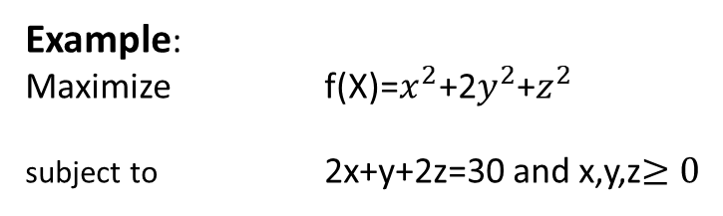
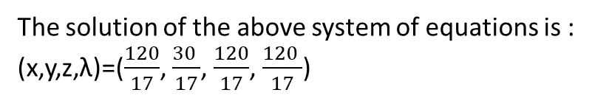
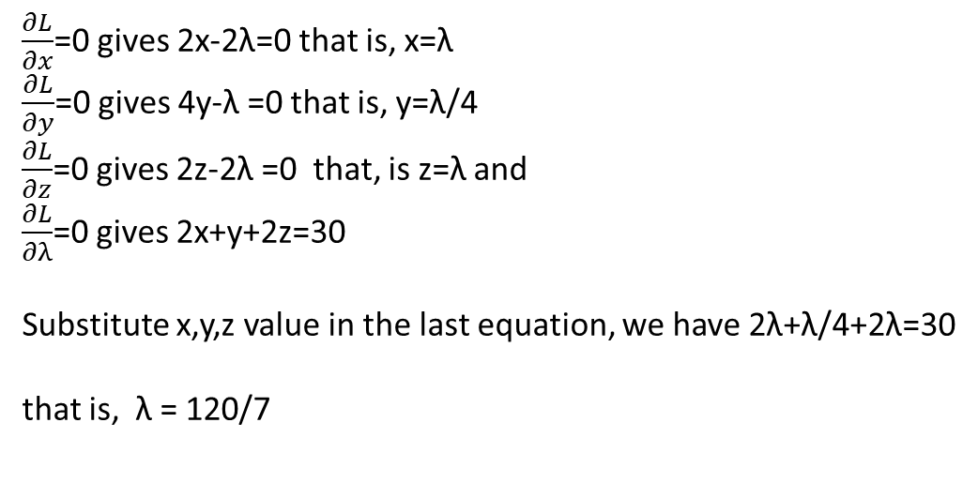
Example:
Maximize f(X)=$x^{2}$+2$y^{2}$+$z^{2}$
subject to 2x+y+2z=30 and x,y,z$≥0$
L(x,y,z,λ)=$x^{2}$+2$y^{2}$+$z^{2}$-λ(2x+y+2z-30)
$\frac{∂L}{∂x}$=0 gives 2x-2λ=0 that is, x=λ
$\frac{∂L}{∂y}$=0 gives 4y-λ =0 that is, y=λ/4
$\frac{∂L}{∂z}$=0 gives 2z-2λ =0 that, is z=λ and
$\frac{∂L}{∂λ}$=0 gives 2x+y+2z=30
Substitute x,y,z value in the last equation, we have 2λ+λ/4+2λ=30
that is, λ = 120/7
The solution of the above system of equations is :
(x,y,z,λ)=($\frac{120}{17}$, $\frac{30 }{17}$, $\frac{120}{17}$, $\frac{120 }{17}$)

Slide 13
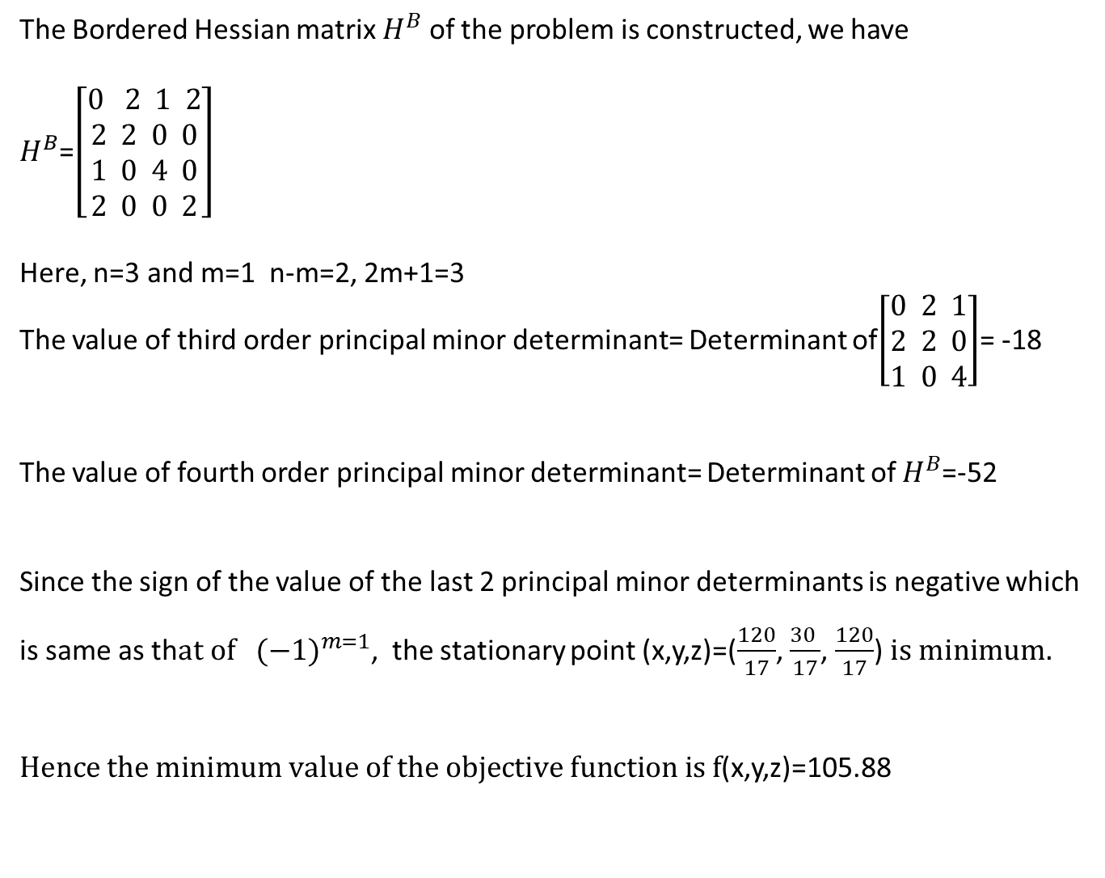
The Bordered Hessian matrix $H^{B}$ of the problem is constructed, we have
$H^{B}$=$\left[\begin{aligned}0 2 1 2 \\ 2 2 0 0 \\ 1 0 4 0 \\ 2 0 0 2\end{aligned}\right]$
Here, n=3 and m=1 n-m=2, 2m+1=3
The value of third order principal minor determinant= Determinant of$\left[\begin{aligned}0 2 1 \\ 2 2 0 \\ 1 0 4\end{aligned}\right]$= -18
The value of fourth order principal minor determinant= Determinant of $H^{B}$=-52
Since the sign of the value of the last 2 principal minor determinants is negative which is same as th$at of {(−1)}^{m=1}$, the stationary point (x,y,z)=($\frac{120}{17}$, $\frac{30 }{17}$, $\frac{120}{17}$) $is minimum.$
$Hence the minimum value of the objective function is f$(x,y,z)=105.88

Slide 14
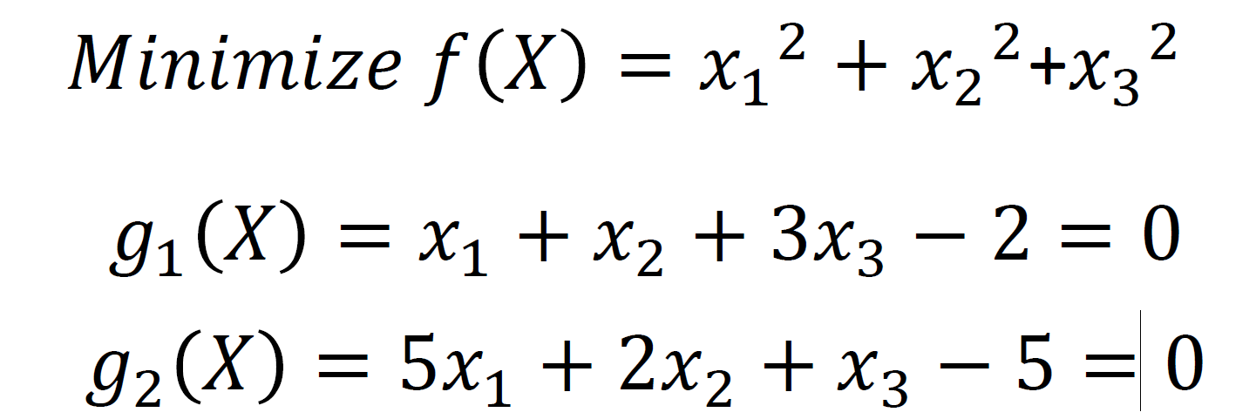
Example

Slide 15
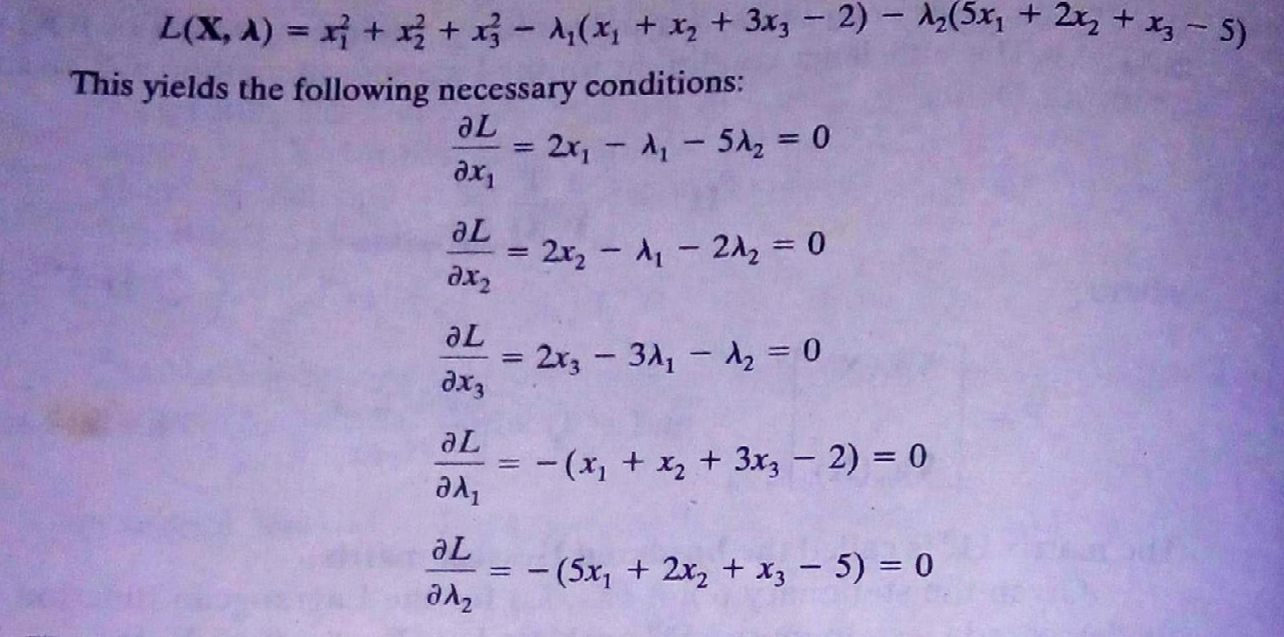

Slide 16
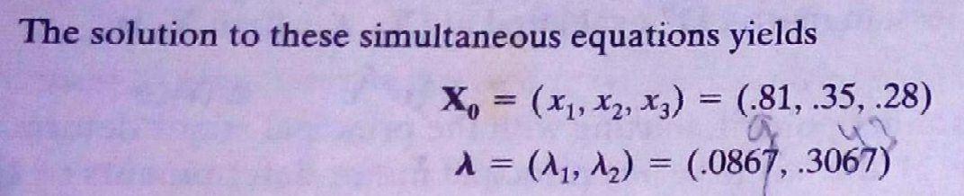

Slide 17


The Bordered Hessian matrix is $H^{B}$=$\left[\begin{aligned}0 0 1 1 3 \\ 0 0 5 2 1 \\ 1 5 2 0 0 \\ 1 2 0 2 0 \\ 1 1 0 0 2\end{aligned}\right]$
Here n=3, m=2
N-m=1, 2m+1=5
|$H^{B}$|=460
Since the sign of this value of is same as ${(−1)}^{m=2}$
Therefore the stationary point ($x_{1, }x_{2, }x_{3}$)=($\frac{37}{46}$, $\frac{16}{46}$, $\frac{13}{46})$
The minimum value of f(x)=f ($\frac{37}{46}$, $\frac{16}{46}$, $\frac{13}{46})=\frac{897}{1058}$=0.85

Slide 18
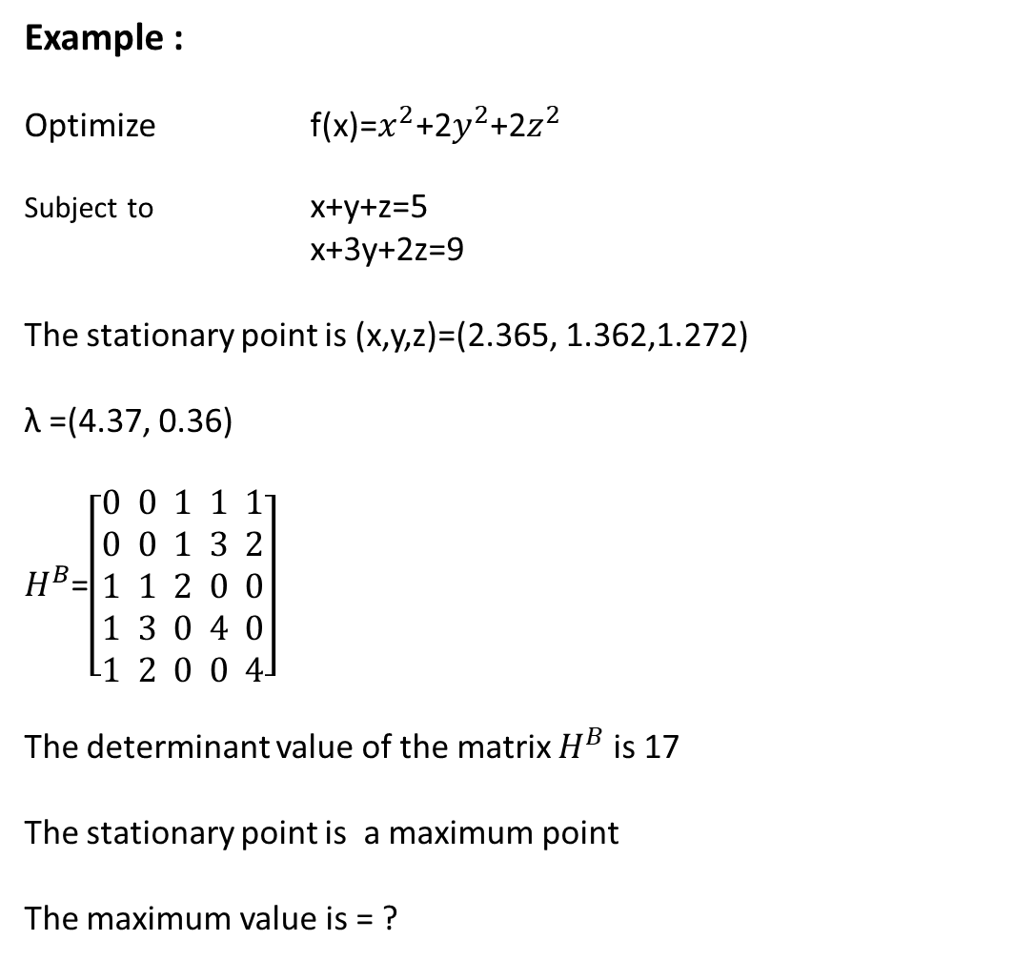
Example :
Optimize f(x)=$x^{2}$+2$y^{2}$+2$z^{2 }$
Subject to x+y+z=5
x+3y+2z=9
The stationary point is (x,y,z)=(2.365, 1.362,1.272)
λ =(4.37, 0.36)
$H^{B}$=$\left[\begin{aligned}0 0 1 1 1 \\ 0 0 1 3 2 \\ 1 1 2 0 0 \\ 1 3 0 4 0 \\ 1 2 0 0 4\end{aligned}\right]$
The determinant value of the matrix $H^{B}$ is 17
The stationary point is a maximum point
The maximum value is = ?

Slide 19
Kuhn-Tucker Conditions
Here we developing the necessary and sufficient conditions for identifying the stationary points of the general inequality constrained optimization problems. These conditions are called the Kuhn-Tucker Conditions. The development is mainly based on Lagrangean method. These conditions are sufficient under certain limitations which will be stated in the following:

Slide 20


Slide 21

The Kuhn Tucker conditions necessary for X to be stationary point for the
Above maximization problem is as follows:
Note: The same conditions apply to minimization problem as well with the difference being that λ must be non=positive.

Slide 22
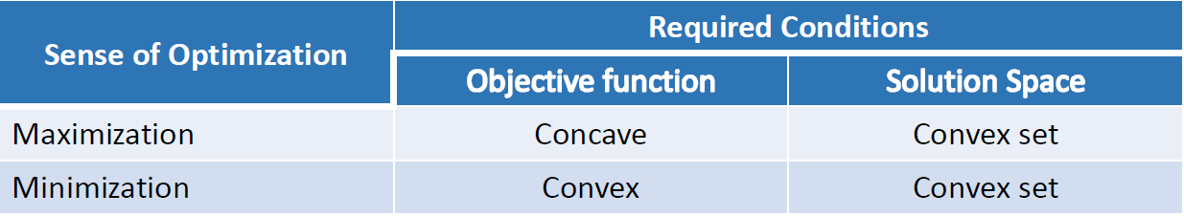
The Kuhn Tucker conditions are also sufficient if the objective function and solution space
Satisfy the following required conditions:

Slide 23
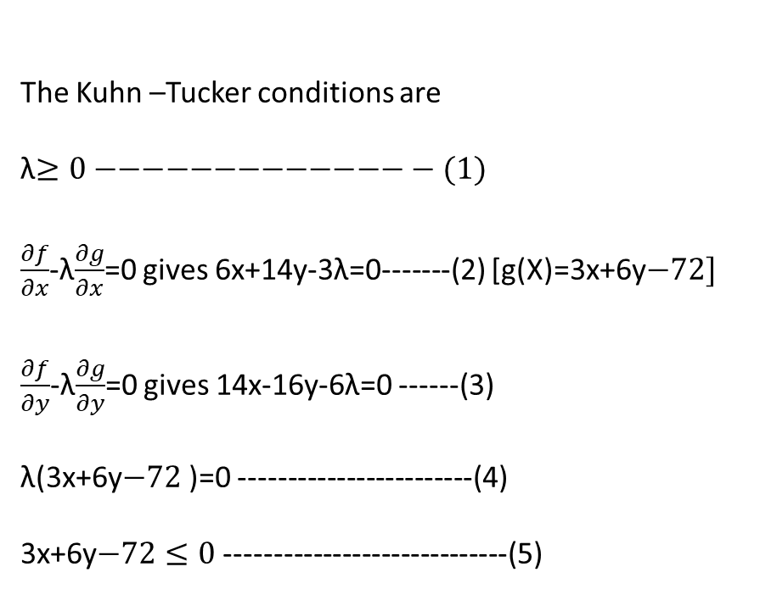
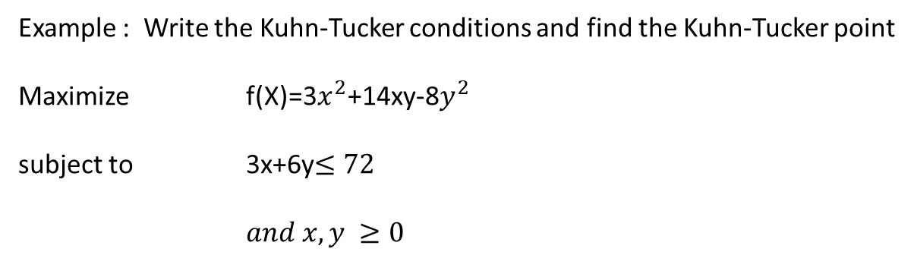
Example : Write the Kuhn-Tucker conditions and find the Kuhn-Tucker point
Maximize f(X)=3$x^{2}$+14xy-8$y^{2}$
subject to 3x+6y$≤72$
$and x,y ≥0$
The Kuhn –Tucker conditions are
λ$≥0−−−−−−−−−−−−−− (1)$
$\frac{∂f}{∂x}$-λ$\frac{∂g}{∂x}$=0 gives 6x+14y-3λ=0-------(2) [g(X)=3x+6y$−72]$
$\frac{∂f}{∂y}$-λ$\frac{∂g}{∂y}$=0 gives 14x-16y-6λ=0 ------(3)
λ(3x+6y$−72$)=0 ------------------------(4)
3x+6y$−72≤0$ -----------------------------(5)

Slide 24

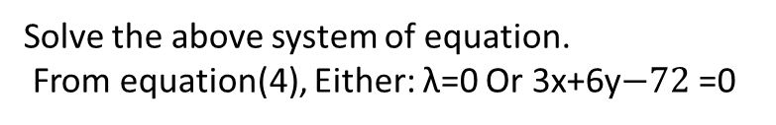
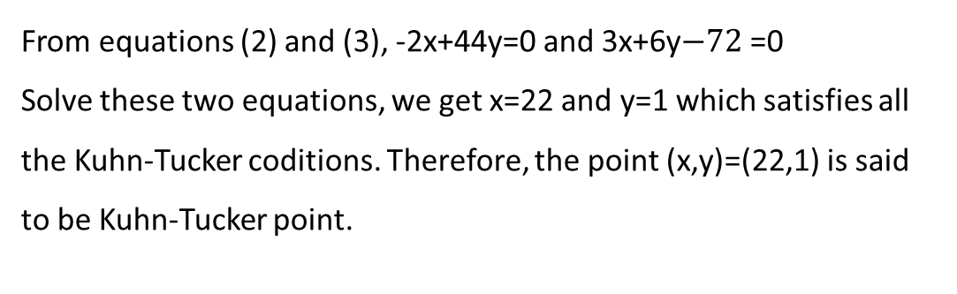
Solve the above system of equation.
From equation(4), Either: λ=0 Or 3x+6y$−72$=0
Case (i) : λ=0
Equation (2) and (3) reduces to 6x+14y=0
14x-16y=0 and solve these two equations
We get x=0 and y= 0. which violates the equation (4).
Case(ii) :λ$≠0$
From equations (2) and (3), -2x+44y=0 and 3x+6y$−72$=0
Solve these two equations, we get x=22 and y=1 which satisfies all the Kuhn-Tucker coditions. Therefore, the point (x,y)=(22,1) is said to be Kuhn-Tucker point.

Slide 25
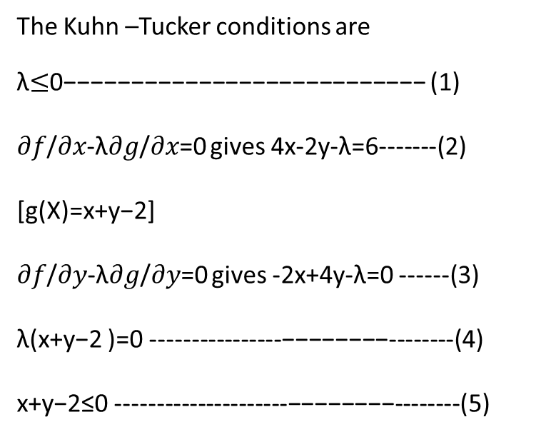
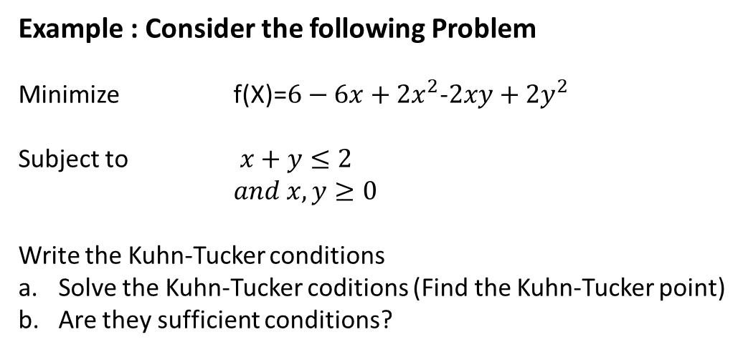
Example : Consider the following Problem
Minimize f(X)=$6−6x+2x^{2}$-$2xy+2y^{2}$
Subject to $x+y≤2$
$and x,y≥0$
Write the Kuhn-Tucker conditions
Solve the Kuhn-Tucker coditions (Find the Kuhn-Tucker point)
Are they sufficient conditions?
The Kuhn –Tucker conditions are
λ$≤$0−−−−−−−−−−−−−−−−−−−−−−−−−−− (1)
𝜕𝑓/𝜕𝑥-λ𝜕𝑔/𝜕𝑥=0 gives 4x-2y-λ=6-------(2) [g(X)=x+y−2]
𝜕𝑓/𝜕𝑦-λ𝜕𝑔/𝜕𝑦=0 gives -2x+4y-λ=0 ------(3)
λ(x+y−2 )=0 ----------------−−−−−−−−--------(4)
x+y−2≤0 ---------------------−−−−−−−−--------(5)

Slide 26
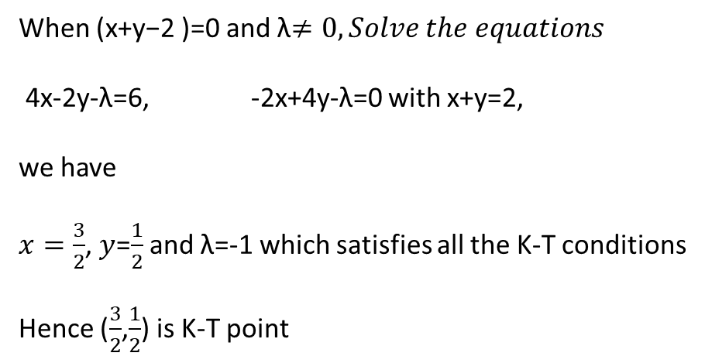
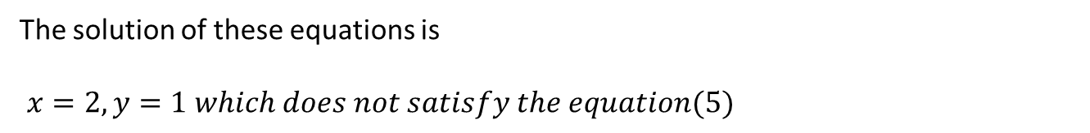
From equation (4), either λ=0 or (x+y−2 )=0
Case (i) When λ=0 , the equations (2) and (3) reduces to
4x-2y=6
-2x+4y=0
The solution of these equations is
$x=2,y=1 which does not satisfy the equation(5)$
Hence, λ=0 does not yield a K-T point
Case (ii)
When (x+y−2 )=0 and λ$≠0, Solve the equations$
4x-2y-λ=6, -2x+4y-λ=0 with x+y=2,
we have
$x=\frac{3}{2}$, $y$=$\frac{1}{2}$ and λ=-1 which satisfies all the K-T conditions
Hence ($\frac{3}{2}$,$\frac{1}{2}$) is K-T point

Slide 27
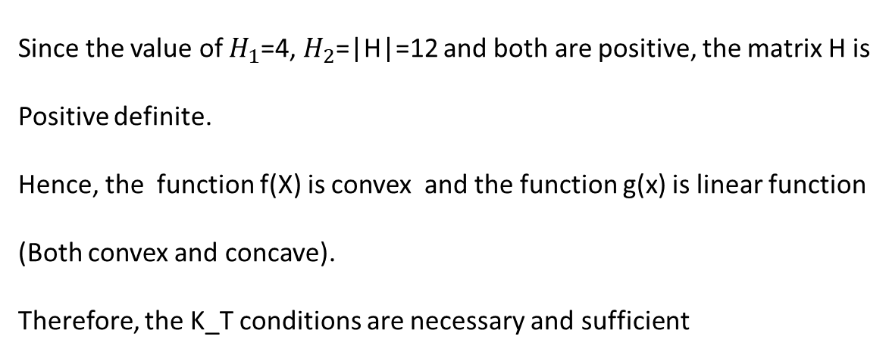
The Hessian matrix of the objective function f(X) is H=$\left[\begin{matrix}4 & −2 \\ −2 & 4\end{matrix}\right]$
Since the value of $H_{1}$=4, $H_{2}$=|H|=12 and both are positive, the matrix H is
Positive definite.
Hence, the function f(X) is convex and the function g(x) is linear function
(Both convex and concave).
Therefore, the K_T conditions are necessary and sufficient
The solution of the problem is $x=\frac{3}{2}$, $y$=$\frac{1}{2}$ and minimum f(X)=$\frac{1}{2}$

Slide 28


Slide 29
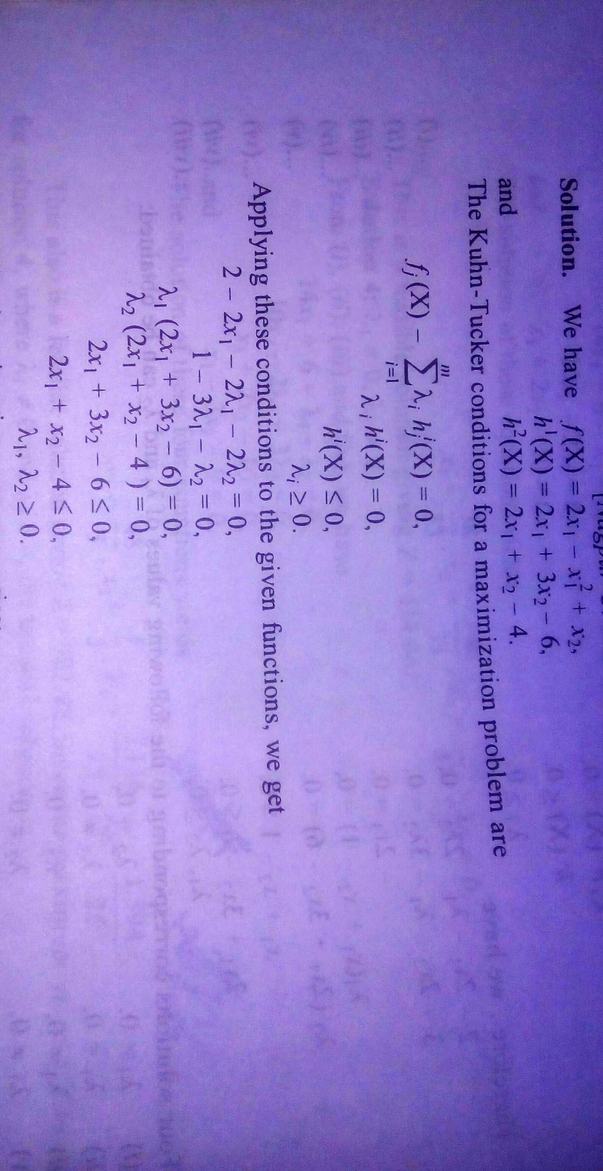

Slide 30
